Slide 1
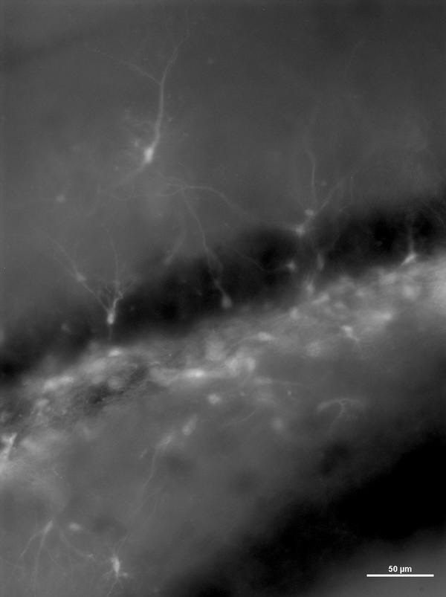
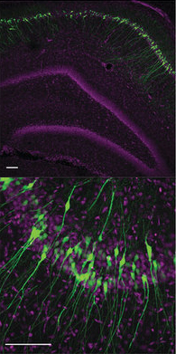
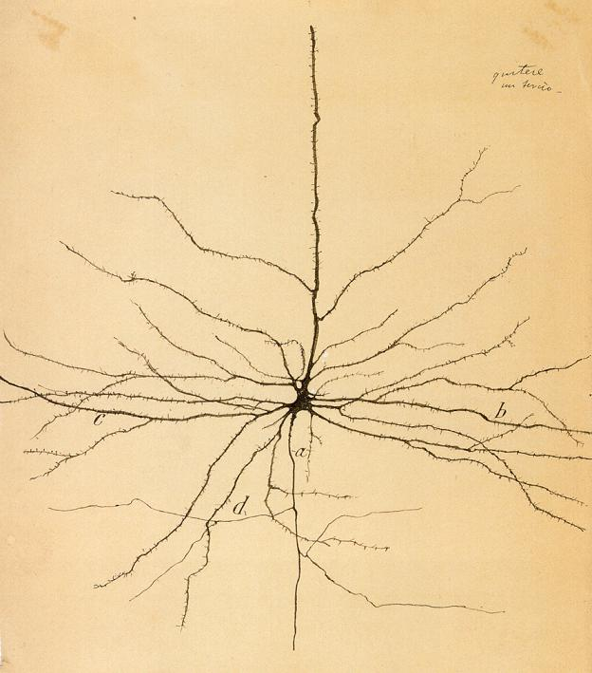
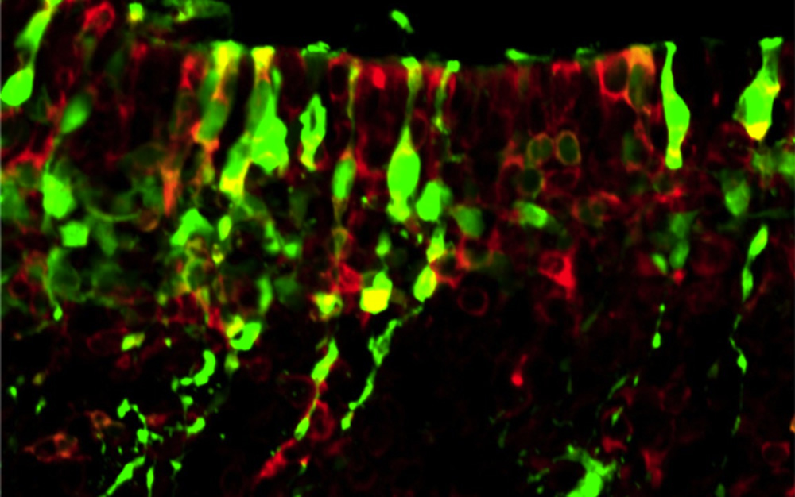
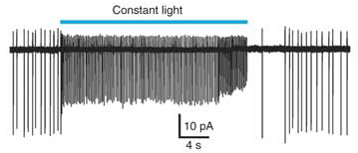
Introduction to Neuroscience

Slide 2
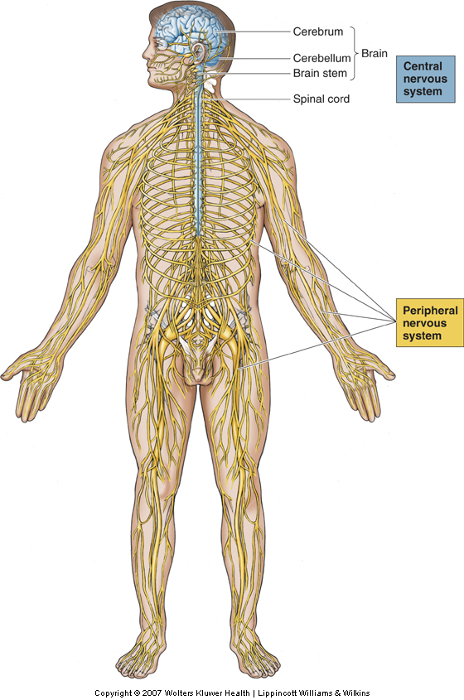
The Nervous System

Slide 3
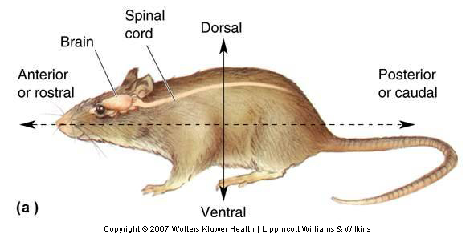
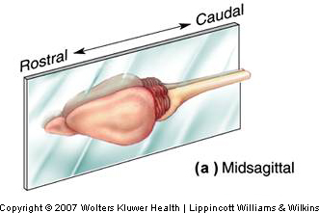
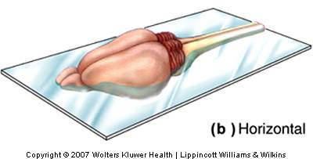
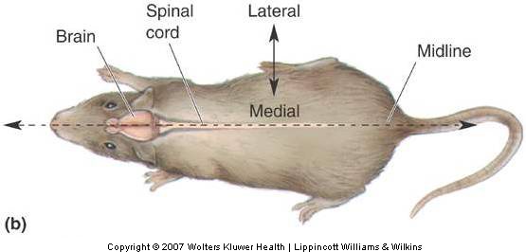
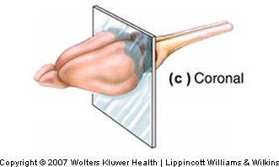
Anatomical References

Slide 4
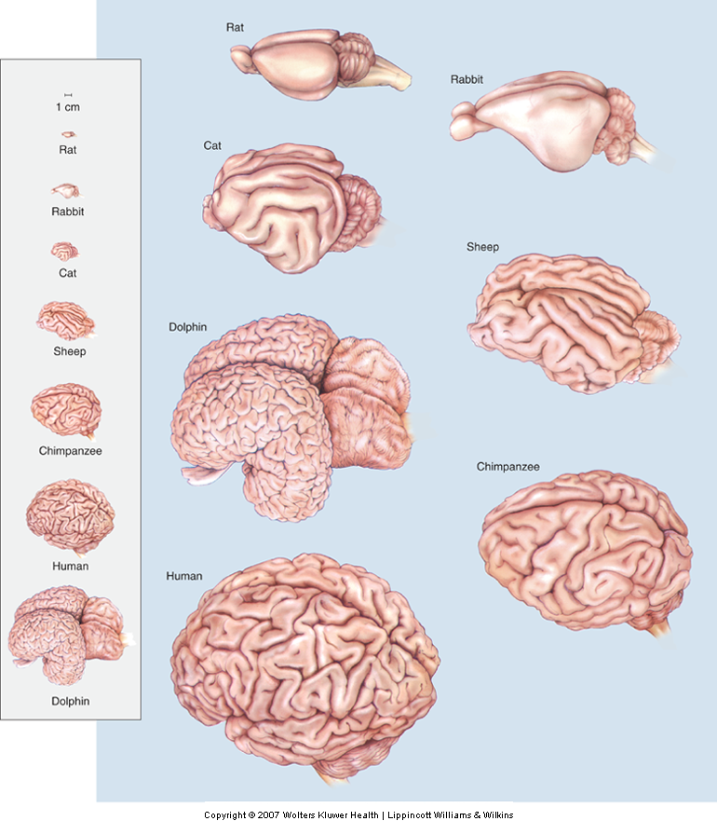
Diversity Amongst Species

Slide 5
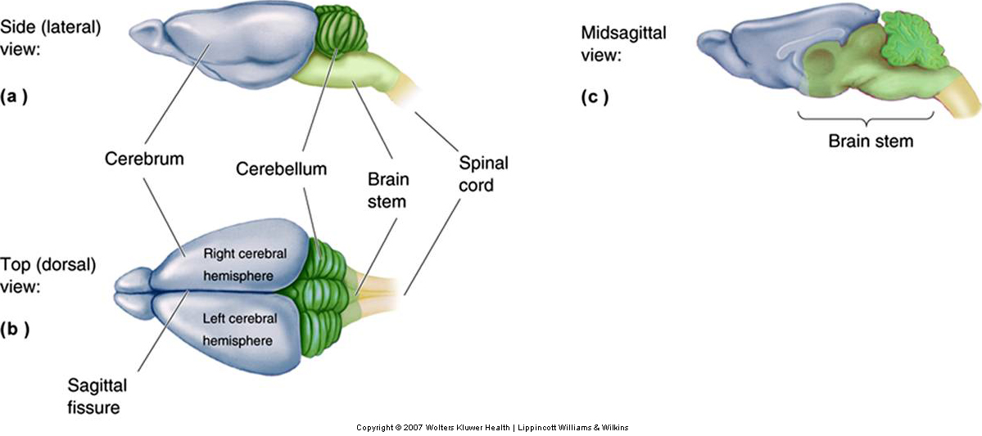
Central Nervous System
  Cerebrum, cerebellum, brain stem
  Spinal Cord

Slide 6
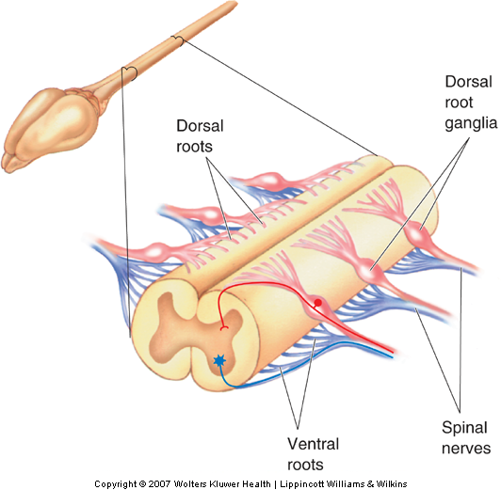
The Spinal Cord
  Location: Attached to the brain stem
  Conduit of information (brain body)
    Skin, joints, muscles
    Spinal nerves
      Dorsal root
      Ventral root

Slide 7
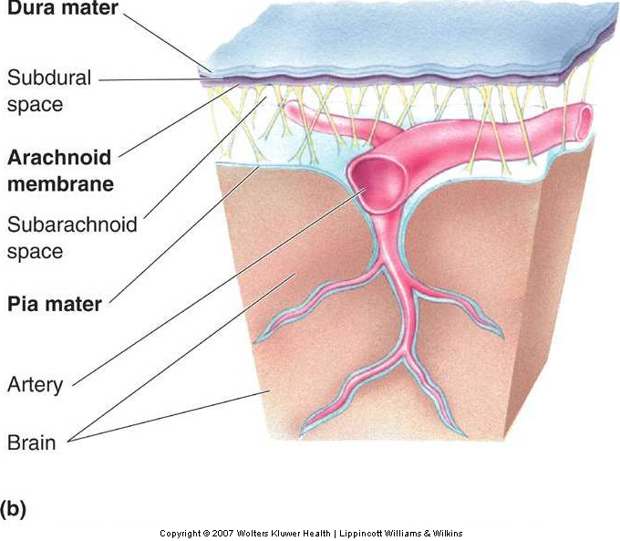
CNS Protection
Meninges
  membranes that surround the
  brain
    Dura mater
    Arachnoid membrane
    Pia mater

Slide 8
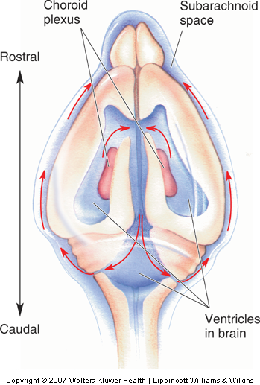
Cerebrospinal fluid
Brain floats in cerebrospinal fluid (CSF)
  Ventricles: CSF-filled caverns and canals inside brain
  Choroid plexus: specialized tissue in ventricles that secretes CSF
  CSF circulates through ventricles; reabsorbed in subarachnoid space

Slide 9
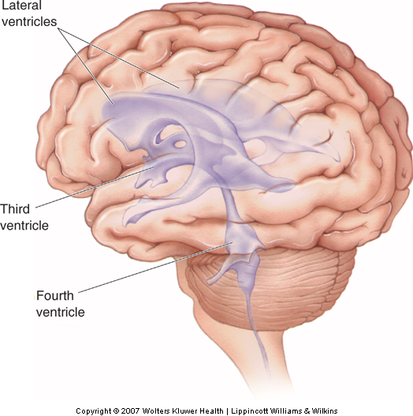
Human ventricular System

Slide 10
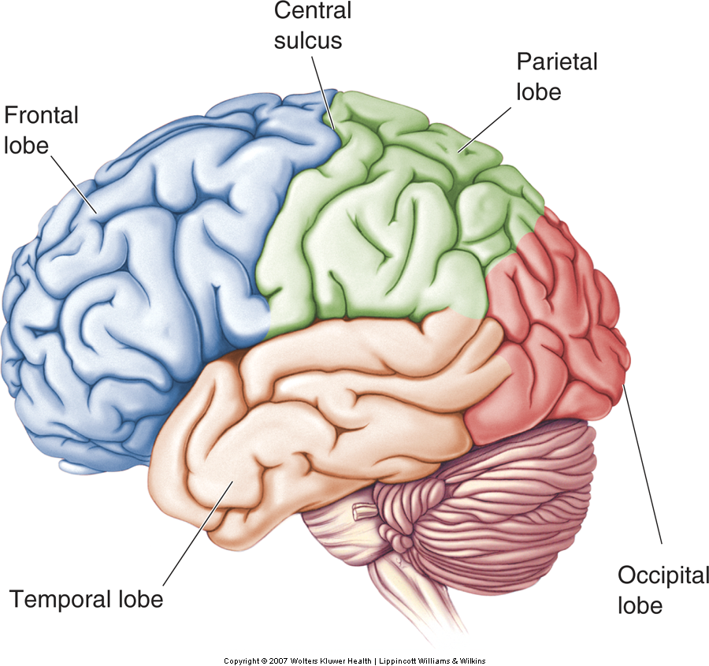
Rough Overview of the Brain
Convolutions on human cerebrum surface called sulci and gyri
4 major lobes: Temporal, frontal, parietal, occipital

Slide 11
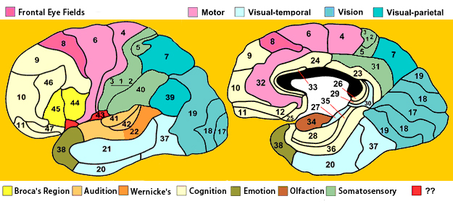
Organization by Structure and Function
Brodmann Areas

Slide 12
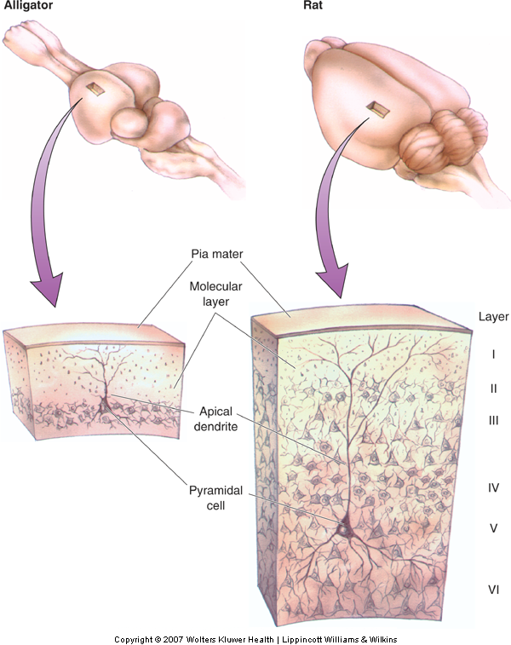
Cortical Organization
Types of Cerebral Cortex
  Common Features
    Cell bodies in layers or sheets
    Surface layer separated from pia mater, layer I
    Apical dendrites form multiple branches

Slide 13
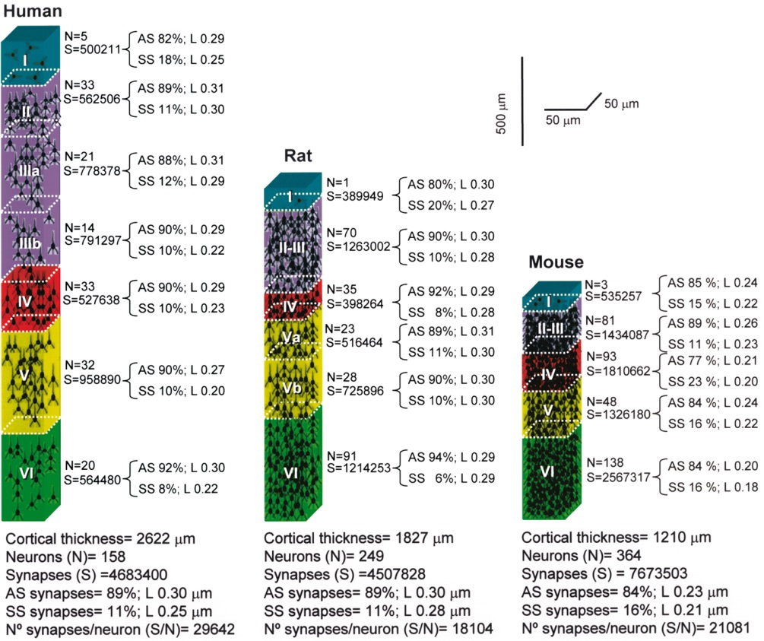
The Human Cortex

Slide 14
The Peripheral Nervous System
  Nervous system outside of the brain and spinal cord
  Somatic PNS: Innervates skin, joints, muscles
  Visceral PNS: Innervates internal organs, blood vessels, glands
  Dorsal root ganglia: Clusters of neuronal cell bodies outside the spinal cord that contain somatic sensory axons

Slide 15
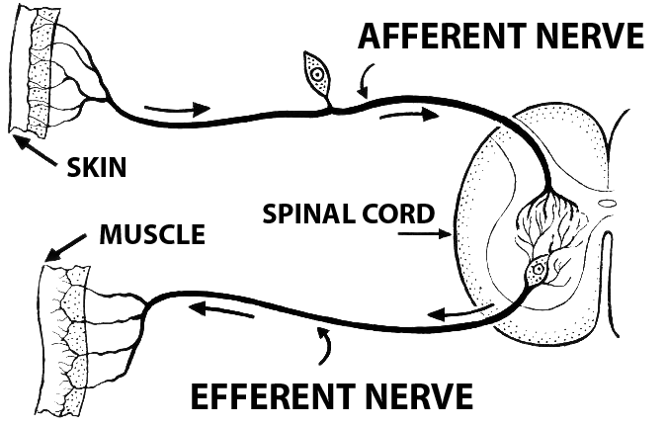
PNS Components
Afferent and Efferent Axons
  Afferent (carry to)
  Efferent (carry from)
The Cranial Nerves
  12 nerves from brain stem
  Mostly innervate the head
  Composition: Axons from CNS, somatic PNS, visceral

Slide 16
Neurons and Glia
Neurophilosophy
  Brain is the origin of mental abilities
Glia and Neurons
  Glia: Insulates, supports, and nourishes neurons
  Neurons
    Process information
    Sense environmental changes
    Communicate changes to other neurons
    Command body response

Slide 17
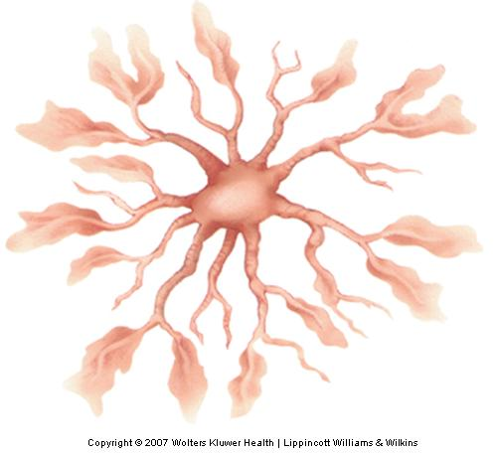
Glia
Function of Glia
  “Supports” neuronal functions
Astrocytes
  Most numerous glia in the brain
  Fill spaces between neurons
  Influence neurite growth
  Regulate chemical content of extracellular space

Slide 18
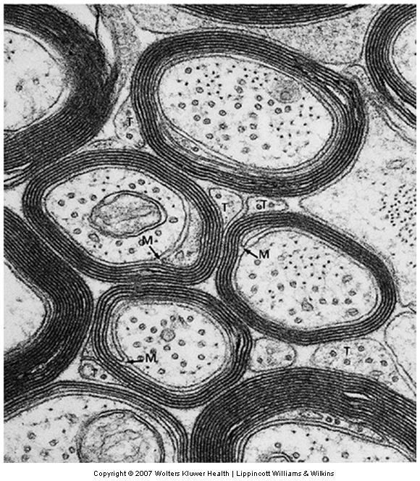
Glia
Myelinating Glia
  Oligodendroglia (in CNS)
  Schwann cells (in PNS)
  Insulate axons

Slide 19
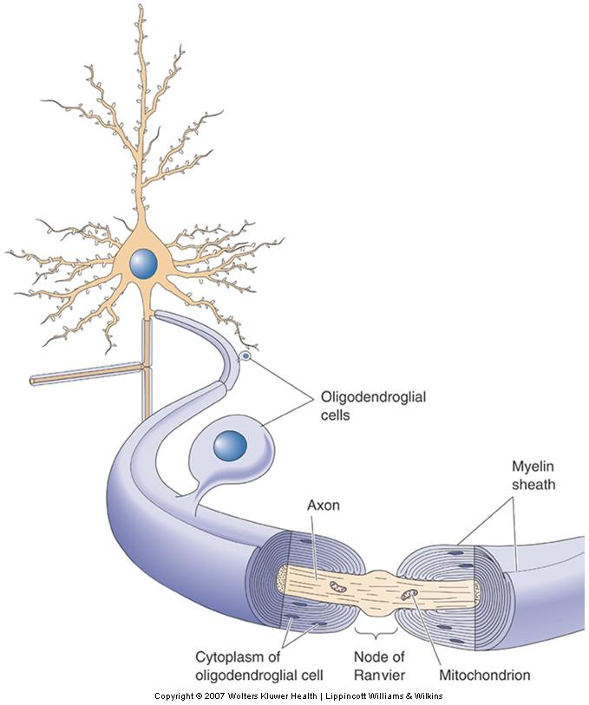
Glia
Myelinating Glia (Cont’d)
  Oligodendroglial cells
  Node of Ranvier
    Region where the axonal membrane is exposed

Slide 20
Getting to know a neuron
Histology
Camillo Golgi
  Golgi stain (silver staining)
Santiago Ramon y Cajal
  Neural circuitry
  Neurons communicate by contact, not a syncytium

Slide 21
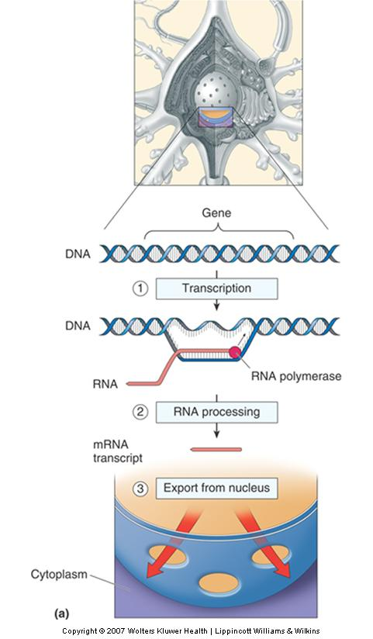
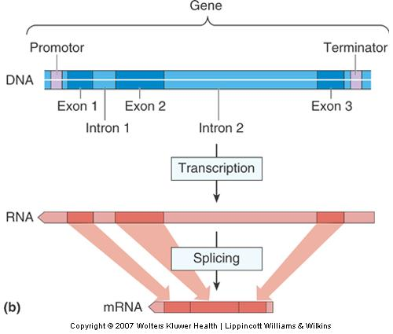
The Prototypical Neuron
The Nucleus
  Gene expression
  Transcription
  RNA processing
  Protein Synthesis

Slide 22
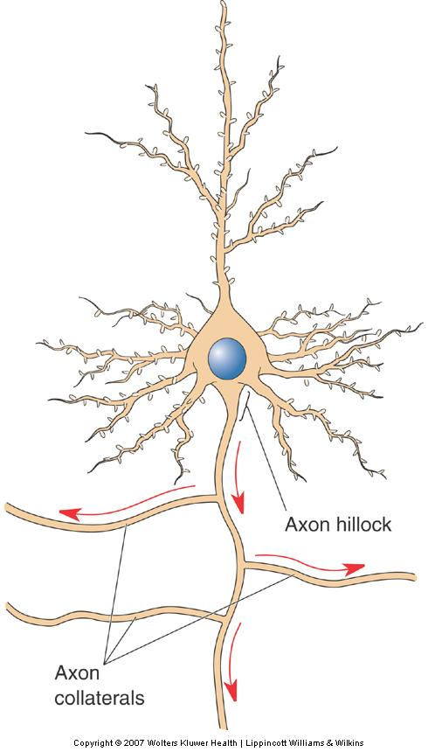
The Prototypical Neuron
The Axon
  Axon hillock (beginning)
  Axon proper (middle)
  Axon terminal (end)
Differences between axon and soma
  ER does not extend into axon
  Protein composition: Unique

Slide 23
The Prototypical Neuron
The Axon
  The Axon Terminal
    Differences between the cytoplasm of axon terminal and axon
      No microtubules in terminal
      Presence of synaptic vesicles
      Abundance of membrane proteins
      Large number of mitochondria

Slide 24
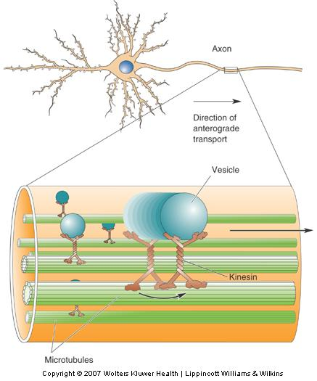
The Prototypical Neuron
The Axon
  Axoplasmic transport
  Anterograde (soma to terminal) vs. Retrograde (terminal to soma) transport

Slide 25
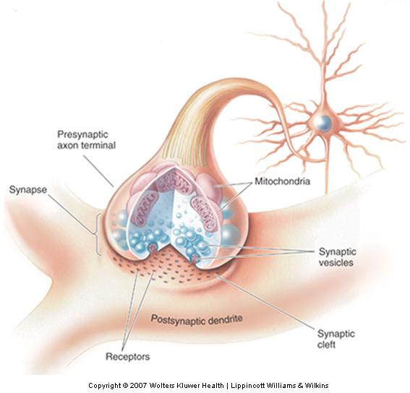
The Prototypical Neuron
The Axon
  Synapse
    Synaptic transmission
    Electrical-to-chemical-to-electrical transformation
    Synaptic transmission dysfunction

Slide 26
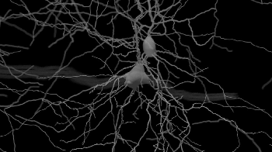
The Prototypical Neuron
Dendrites
  “Antennae” of neurons
  Dendritic tree
  Synapse - receptors
  Dendritic spines
    Postsynaptic (receives signals from axon terminal)

Slide 27
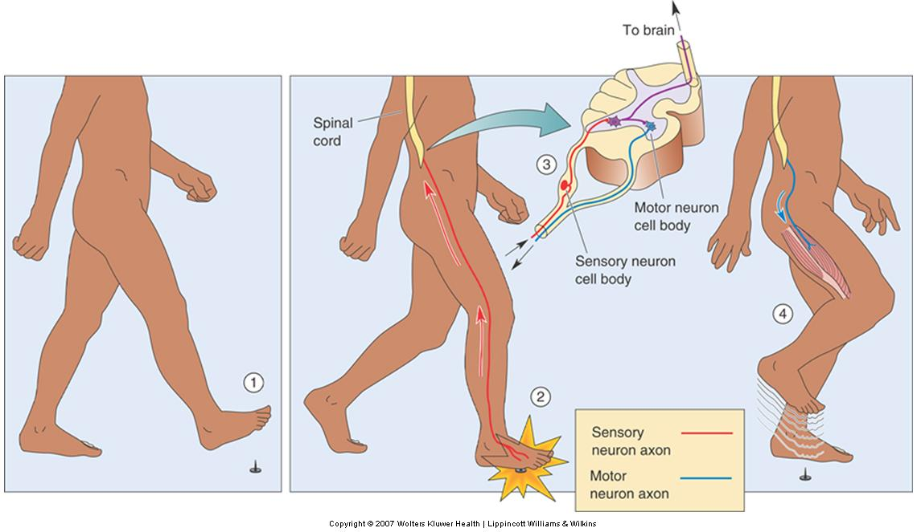
How do neurons communicate?
Electrical to chemical transmission
Membrane dynamics
  Action potential vs. resting potential

Slide 28
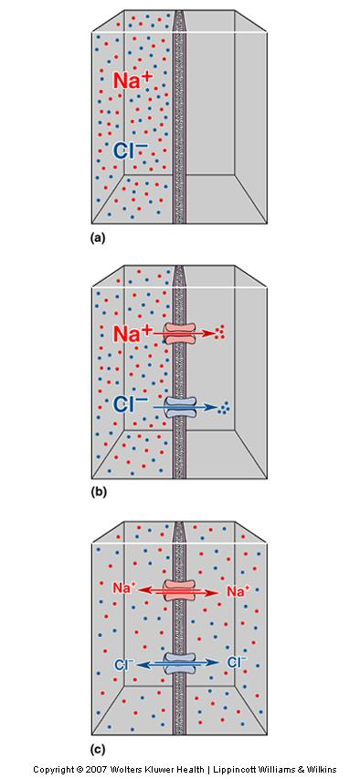
The Movement of Ions
Diffusion
  Dissolved ions distribute evenly
  Ions flow down concentration gradient when:
    Channels permeable to specific ions
    Concentration gradient across the membrane

Slide 29
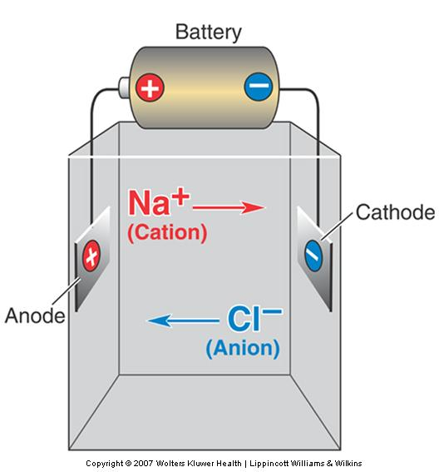
The Movements of Ions
Electricity
    Electrical current influences ion movement
    Electrical conductance (g) and resistance (R); R = 1/g
    Electrical potential (voltage)

Slide 30
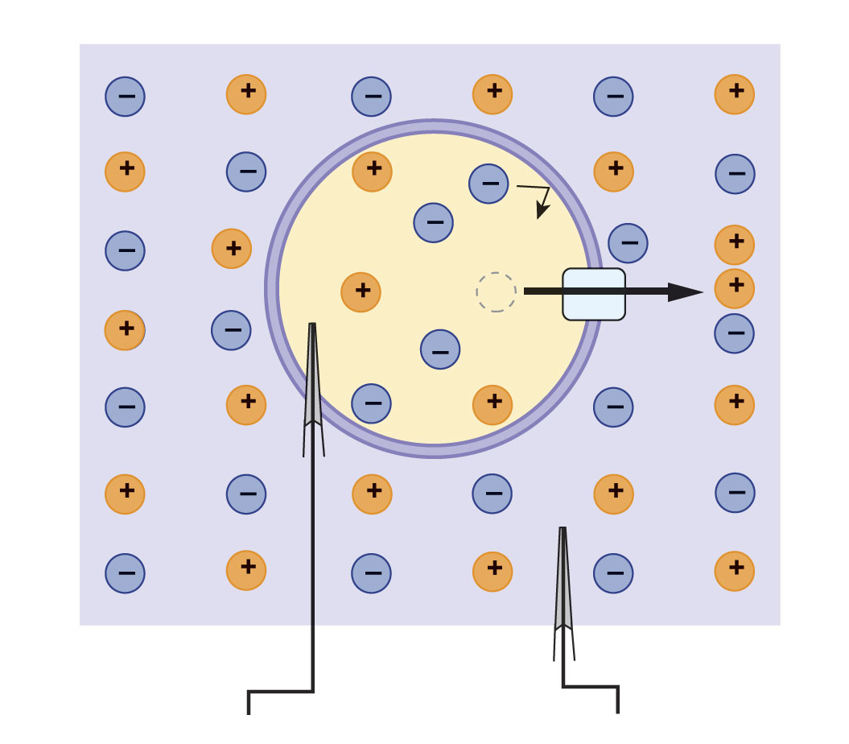
Separation of Electrical Charges
Resting membrane potential is the electrical gradient between ECF and ICF
(b)
Cell and solution in chemical and electrical disequilbrium.
Intracellular fluid
Extracellular fluid

Slide 31
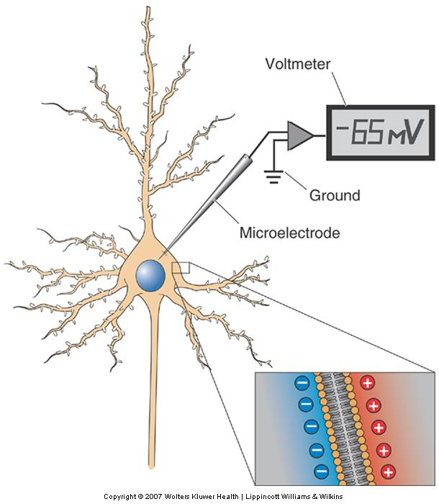
The Resting Membrane Potential
Equilibrium Potentials
  Four important points
    Large changes in V_{m}
      Minuscule changes in ionic concentrations
    Net difference in electrical charge
      Inside and outside membrane surface
    Rate of movement of ions across membrane
      Proportional V_{m} – E_{ion}
    Concentration difference known: Equilibrium potential can be calculated

Slide 32

Altering Membrane Permeability
Gated ion channels alternate between open and closed states
  Na⁺
  K⁺
  Ca²⁺
  Cl⁻

Slide 33
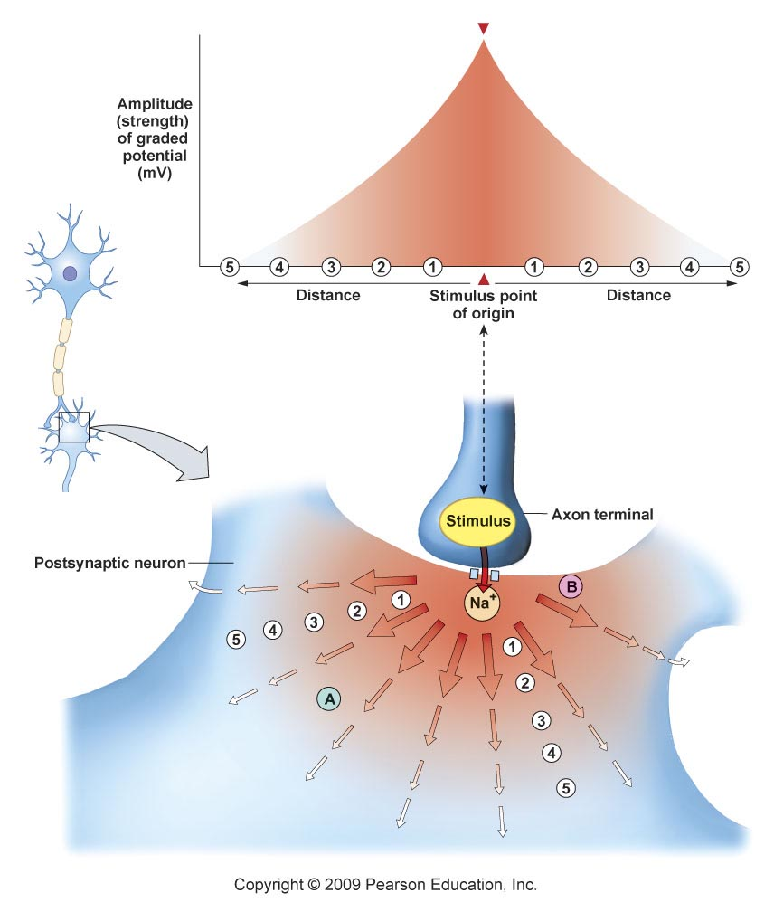
Electrical Signals: Graded Potentials
Graded potentials decrease in strength as they spread out from the point of origin

Slide 34


Graded Potentials Lose Strength Over Distances
Current leak-some of the positive ions leak back across the membrane
Cytoplasmic resistance (Axial Resistance)
  A graded potential will travel along a neurite via passive conduction

Slide 35
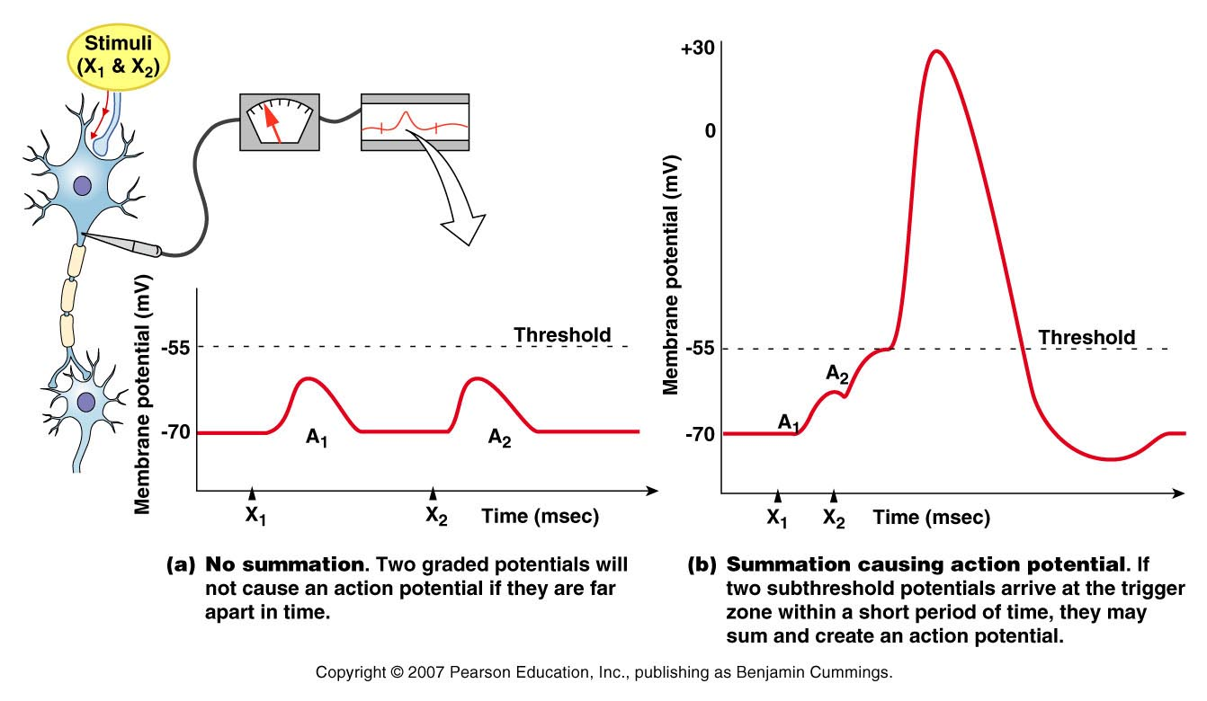
Temporal Summation

Slide 36
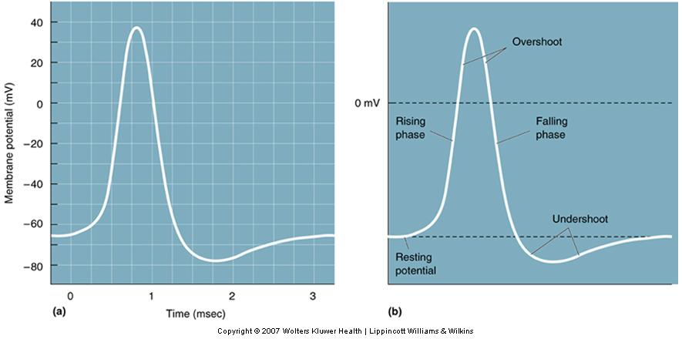
Properties of the Action Potential
The Ups and Downs of an Action Potential
  Oscilloscope to visualize an AP
    Rising phase, overshoot, falling phase, and undershoot

Slide 37
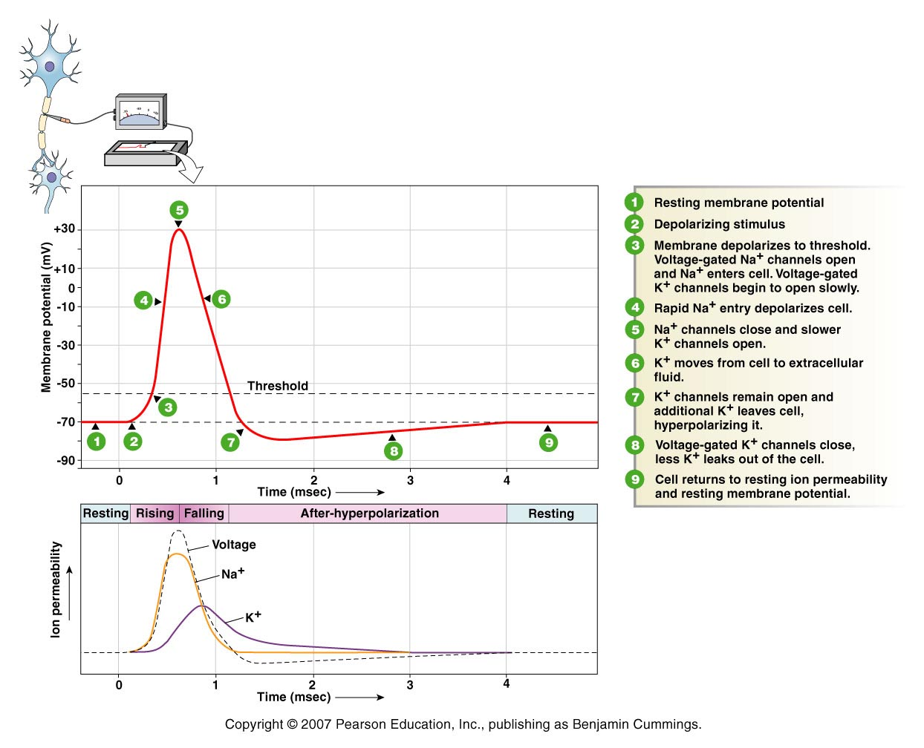
This shows one section of membrane during an Action Potential

Slide 38
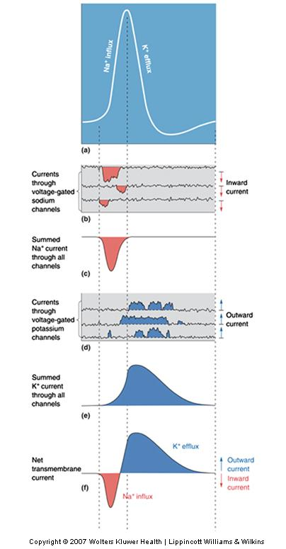
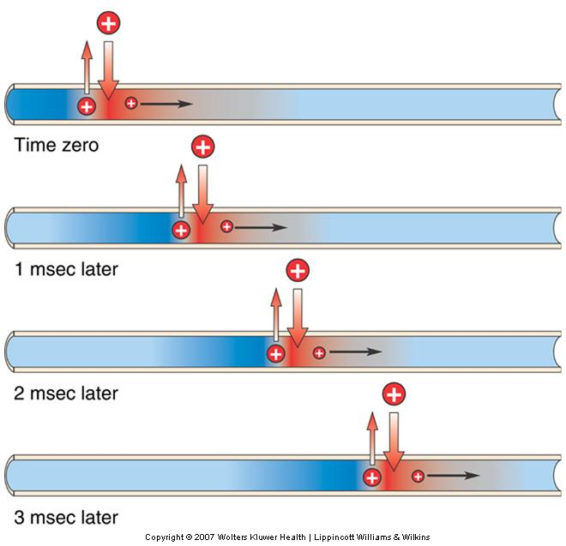
Propagation of the AP

Slide 39
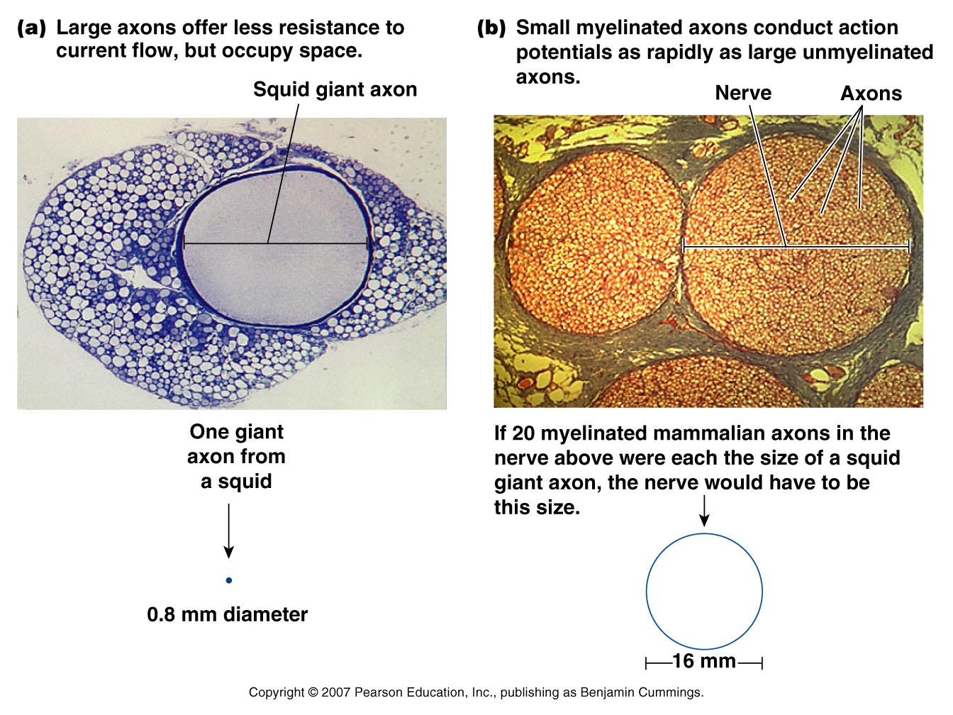

Slide 40
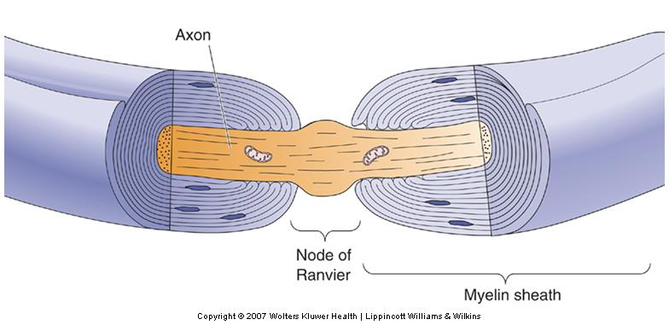
Action Potential Conduction
Factors Influencing Conduction Velocity
  Myelin: Layers of myelin sheath facilitate current flow
    Myelinating cells
      Schwann cells in the PNS
      Oligodendroglia in CNS

Slide 41
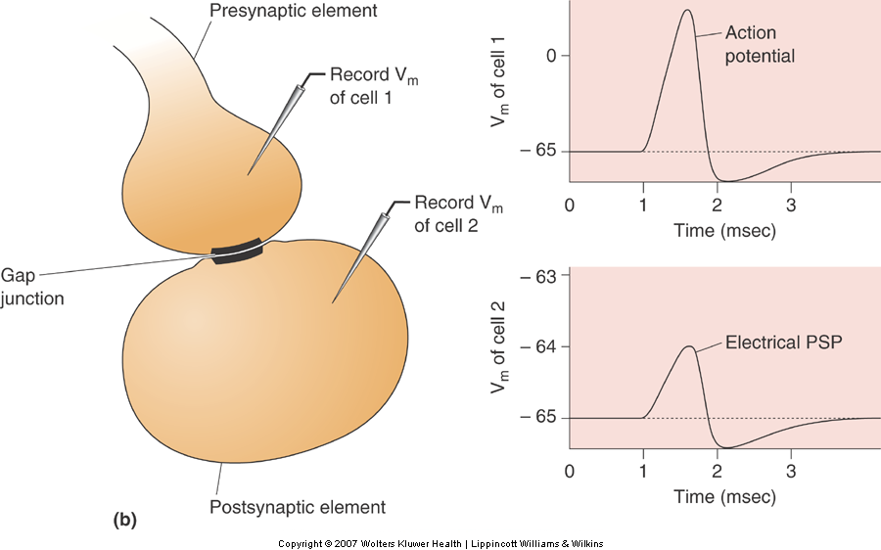
Typical Neuron to Neuron Communication

Slide 42
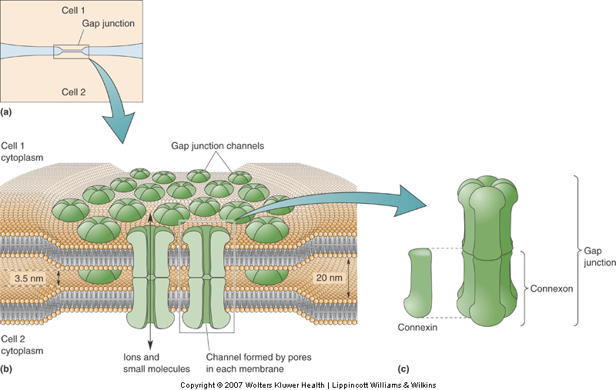
Types of Synapses
Electrical Synapses
  Gap junction
    Channel
      Connexon- formed by six connexins
  Cells are said to be “electrically coupled”
    Flow of ions from cytoplasm to cytoplasm

Slide 43
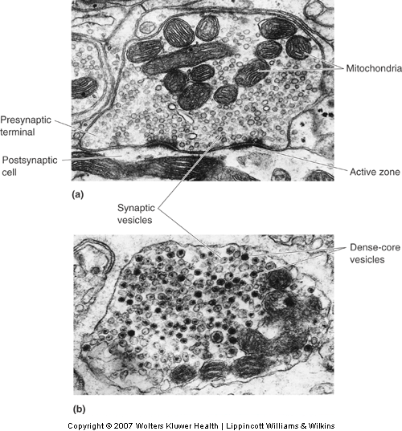
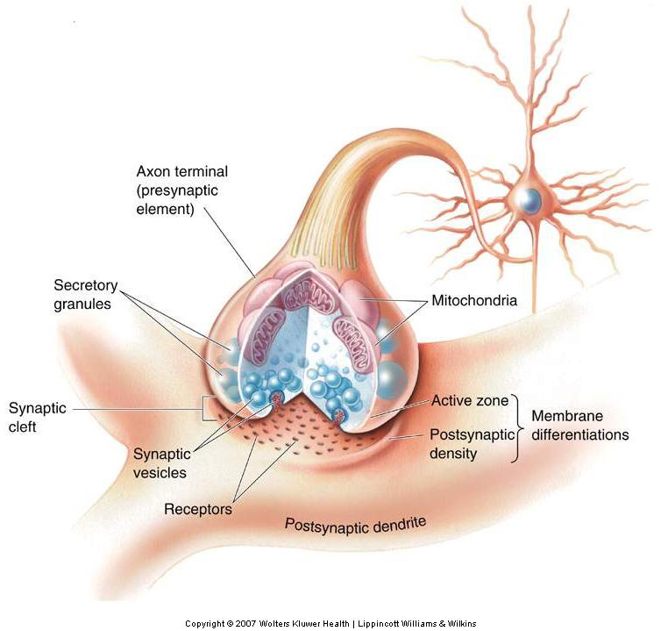
Chemical Synapses

Slide 44
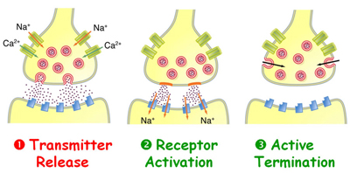
Principles of Chemical Synaptic Transmission
Basic Steps
  Neurotransmitter synthesis
  Load neurotransmitter into synaptic vesicles
  Vesicles fuse to presynaptic terminal
  Neurotransmitter spills into synaptic cleft
  Binds to postsynaptic receptors
  Biochemical/Electrical response elicited in postsynaptic cell
  Removal of neurotransmitter from synaptic cleft

Slide 45
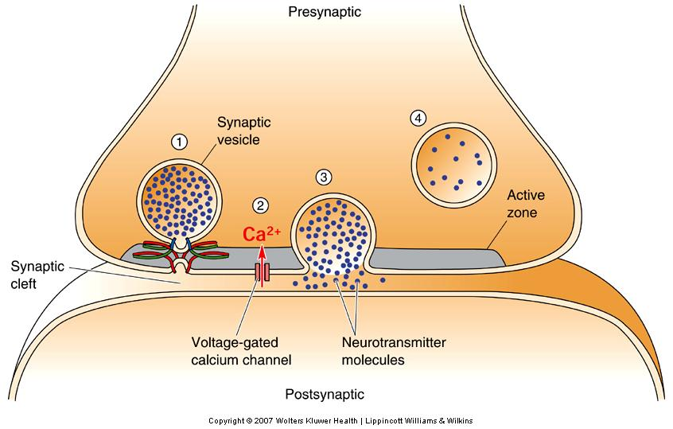
Chemical Synaptic Transmission
Neurotransmitter Release
  Exocytosis: Process by which vesicles release their contents

